Slide 1
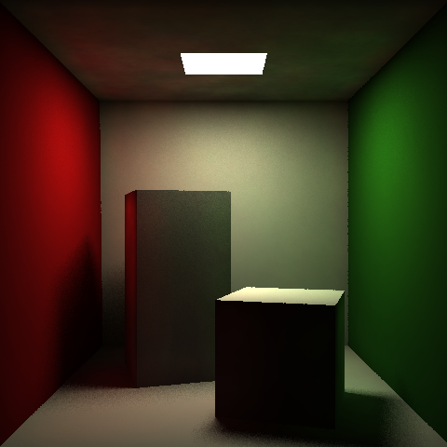
Illumination and Light Transport
Cornell box rendered using photon mapping
Chapters 29, 31, 33
Photo credit: Ben Herila, 2010

Slide 2
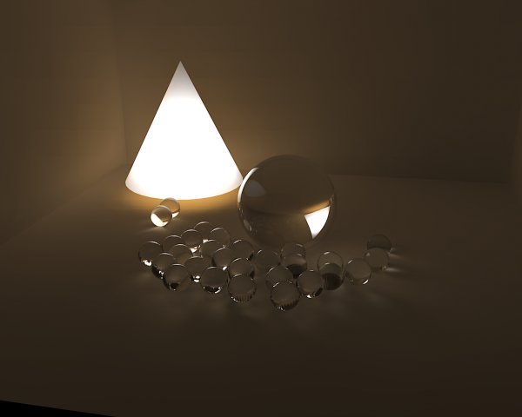
Outline
What is Light?
Local vs. Global Illumination
The Rendering Equation
Illumination vs. Shading
Computing Illumination
Modeling Reflectance
Illumination Models
Shading Models
Advanced Global Illumination Techniques
Photo source : http://www.overclock.net/art-graphics/251218-kerkythea-shaded-lightsource-test.html

Slide 3
The Microscopic View of Light
Light can be thought of as small packets of energy called photons
Every atom has a nucleus which electrons orbit at various levels
When an electron drops from a higher level orbit to a lower, energy (photons) are emitted (Planck’s Law)
E=hf (frequency of emitted light increases with energy, h is Planck’s constant)
When an emitted photon strikes another atom and is absorbed, electrons jump from a lower orbital to a higher one
The wavelength (color) of light emitted or absorbed corresponds to the change in orbital.
The nature of atoms and their electrons control the type of light emission
See chapter 26 in book
E2
E1

Slide 4
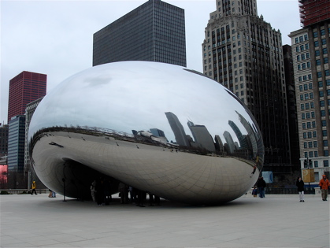
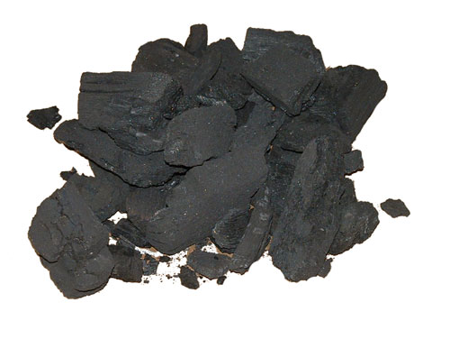
The Microscopic View of Light
The different energy levels of electrons allow for different wavelengths of light to be reflected
Metals have “loose” electrons which can move relatively freely and occupy many different energy levels, which is why they are more reflective
Insulators have more constrained electrons which cannot change energy levels as easily, so they convert more absorbed light into heat instead of reflecting it
Cloud Gate, Millenium Park, Chicago http://greghumphries.com/
Charcoal, source: http://budgetwarehouse.wordpress.com/party-needs/charcoal/

Slide 5
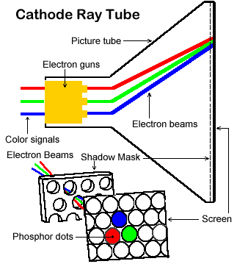
The Microscopic View of Light
To create light, excite an object’s electrons (heating the object)
heat causes atoms to vibrate, which may result in the “kicking around” of a loose electron; the energy can be released
in the form a photon, light, or heat
CRT cathode boils off electrons with high kinetic energy; those electrons bombard phosphor molecules and cause phosphor electrons to escape their shells, then fall back and release visible energy in R, G, or B range, as a function of what color phosphor in the pixel’s triad it hits
light decays exponentially, refresh >= 60 Hz
refresh is obviated in flat panel displays

Slide 6
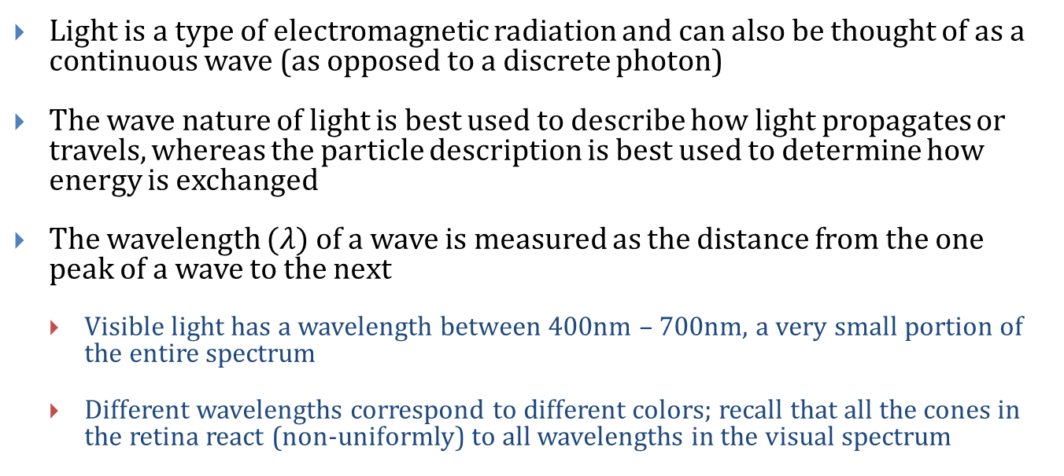
The Macroscopic View of Light
Light is a type of electromagnetic radiation and can also be thought of as a continuous wave (as opposed to a discrete photon)
The wave nature of light is best used to describe how light propagates or travels, whereas the particle description is best used to determine how energy is exchanged
The wavelength $(λ)$ of a wave is measured as the distance from the one peak of a wave to the next
Visible light has a wavelength between 400nm – 700nm, a very small portion of the entire spectrum
Different wavelengths correspond to different colors; recall that all the cones in the retina react (non-uniformly) to all wavelengths in the visual spectrum

Slide 7
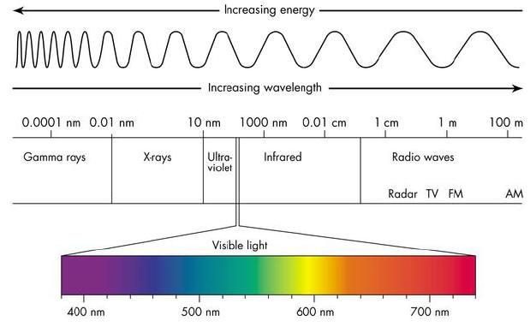
The Electromagnetic Spectrum
Full electromagnetic spectrum
Visible light has a wavelength between 400nm – 700nm, tiny portion of spectrum
We’re only interested in the visible spectrum – define and group major wavelength ranges, approximately
red, green, and blue

Slide 8
Outline
What is Light?
Local vs. Global Illumination
The Rendering Equation
Illumination vs. Shading
Computing Illumination
Modeling Reflectance
Illumination Models
Shading Models
Advanced Global Illumination Techniques

Slide 9
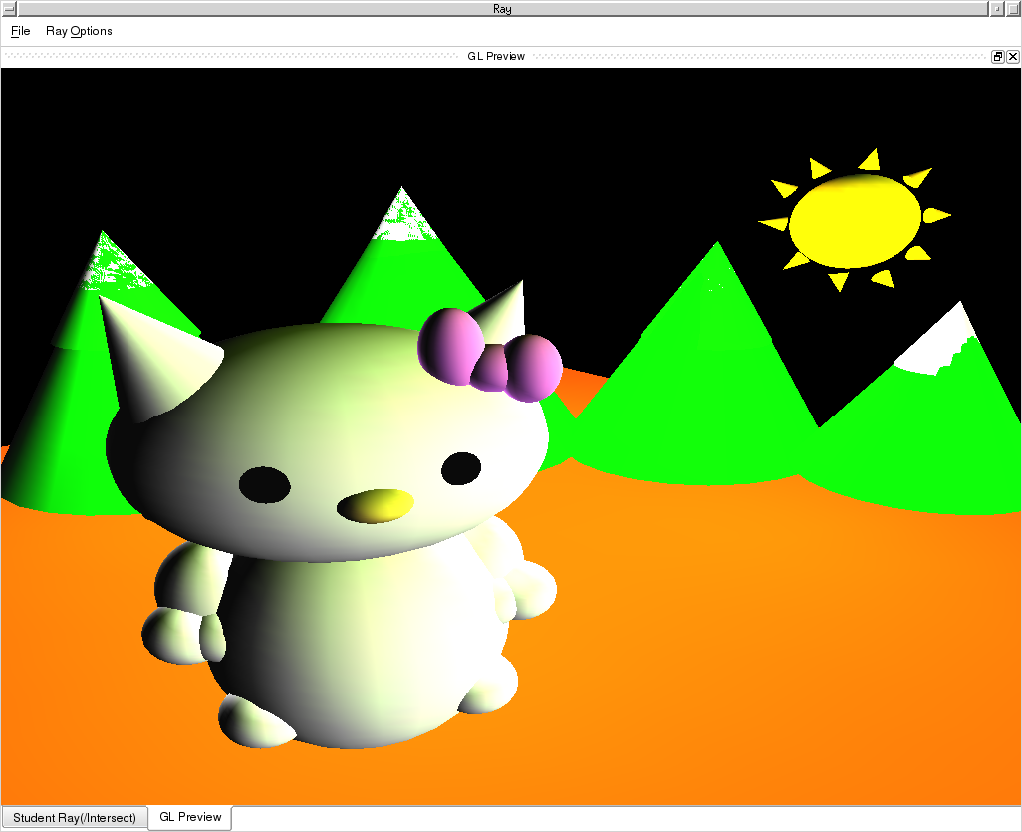
Illumination Models: Direct (non-global) Illumination
Crudest hack: take only direct lighting information from light sources into account when computing a sample
Usually involves an “ambient term” to set a sort of minimum bar for inter-object reflection and thus light up visible surfaces
Used in OpenGL, most traditional hardware pipelines (“fixed function” as opposed to programmable shader driven pipelines on modern GPUs)
Nancy Tom’s Sceneview scene, rendered using OpenGL with only local illumination (2001).

Slide 10
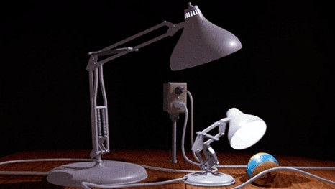
Illumination Models: Global Illumination
Simulates how other objects affect light reaching a surface element
Lights and shadows
most light striking a surface element comes directly from emissive light sources
sometimes light from a source to a surface element is blocked by other objects; surface element is then in “shadow” from that light source
classical h/w pipeline doesn’t account for blockers since each triangle is considered purely by itself
Inter-object reflection (indirect illumination)
light bounces off other objects toward our surface element, to add to direct illumination
from Pixar’s “Luxo Jr.”
eye
indirect illumination
object
direct illumination
light
object
object
light

Slide 11
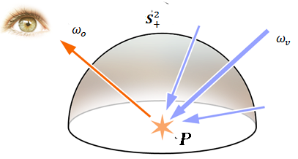
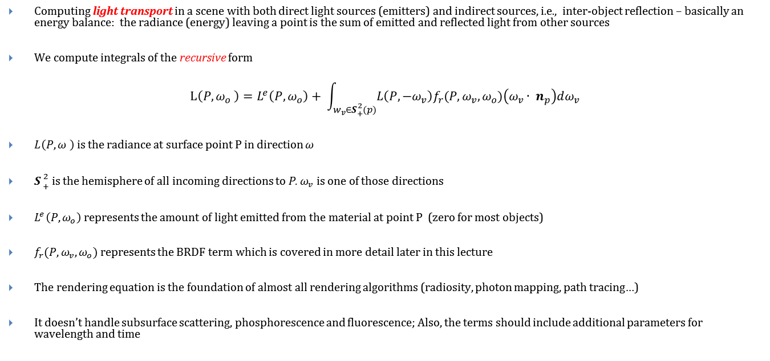
The Rendering Equation (Kajiya, Immel et al, 1986)
Computing light transport in a scene with both direct light sources (emitters) and indirect sources, i.e., inter-object reflection – basically an energy balance: the radiance (energy) leaving a point is the sum of emitted and reflected light from other sources
We compute integrals of the recursive form
$$L\left(P,ω_{o} \right)=L^{e}\left(P, ω_{o}\right)+ \int_{w_{v}∈S{2 \atop +}(p)}{L\left(P,{−ω}_{v}\right)f_{r}(P, ω_{v}, ω_{o}})\left(ω_{v}∙ n_{p}\right)dω_{v}$$
$L\left(P,ω \right)$ is the radiance at surface point P in direction $ω$
$S{2 \atop +}$ is the hemisphere of all incoming directions to P. $ω_{v}$ is one of those directions
$L^{e}\left(P, ω_{o}\right)$ represents the amount of light emitted from the material at point P (zero for most objects)
$f_{r}(P, ω_{v}, ω_{o})$ represents the BRDF term which is covered in more detail later in this lecture
The rendering equation is the foundation of almost all rendering algorithms (radiosity, photon mapping, path tracing…)
It doesn’t handle subsurface scattering, phosphorescence and fluorescence; Also, the terms should include additional parameters for wavelength and time
Image courtesy of: http://en.wikipedia.org/wiki/Rendering_equation

Slide 12
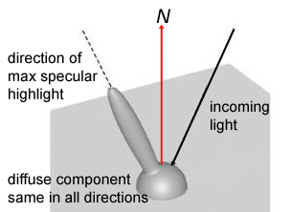
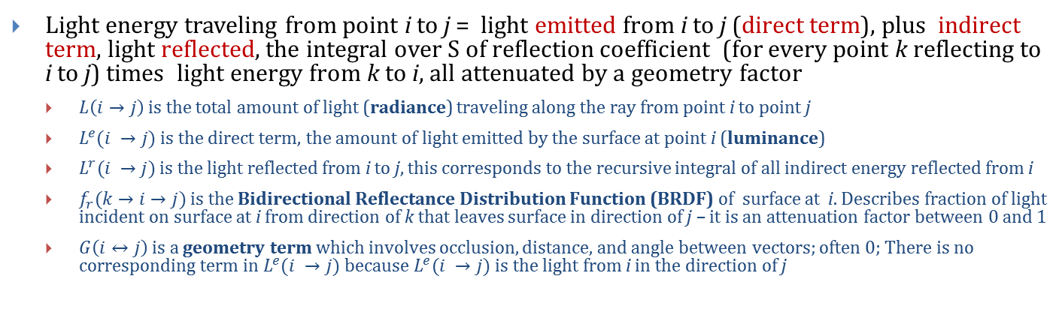
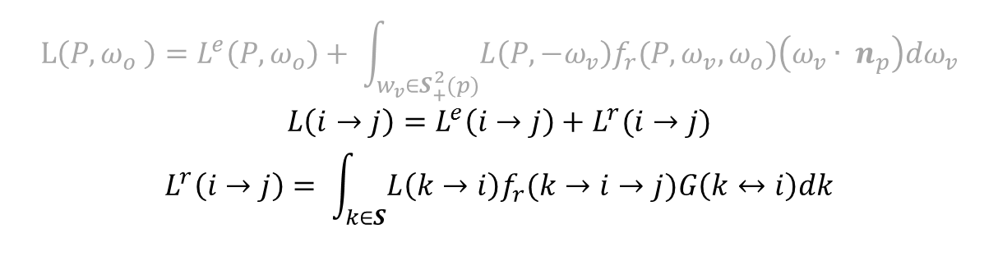
The Rendering Equation in another form
$$L\left(P,ω_{o} \right)=L^{e}\left(P, ω_{o}\right)+ \int_{w_{v}∈S{2 \atop +}(p)}{L\left(P,{−ω}_{v}\right)f_{r}(P, ω_{v}, ω_{o}})\left(ω_{v}∙ n_{p}\right)dω_{v}$$
$$L\left(i→j\right)=L^{e}\left(i→j\right)+L^{r}(i→j)$$
$$L^{r}\left(i→j\right)= \int_{k∈S}{L\left(k→i\right)f_{r}(k→i→j})G\left(k↔i\right)dk$$
BRDF
Light energy traveling from point i to j = light emitted from i to j (direct term), plus indirect term, light reflected, the integral over S of reflection coefficient (for every point k reflecting to i to j) times light energy from k to i, all attenuated by a geometry factor
$L\left(i→j\right)$ is the total amount of light (radiance) traveling along the ray from point i to point j
$L^{e}(i →j)$ is the direct term, the amount of light emitted by the surface at point i (luminance)
$L^{r}(i →j)$ is the light reflected from i to j, this corresponds to the recursive integral of all indirect energy reflected from i
$f_{r}(k→i→j)$ is the Bidirectional Reflectance Distribution Function (BRDF) of surface at i. Describes fraction of light incident on surface at i from direction of k that leaves surface in direction of j – it is an attenuation factor between 0 and 1
$G\left(i↔j\right)$ is a geometry term which involves occlusion, distance, and angle between vectors; often 0; There is no corresponding term in $L^{e}(i →j)$ because $L^{e}(i →j)$ is the light from i in the direction of j

Slide 13
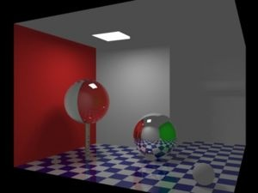
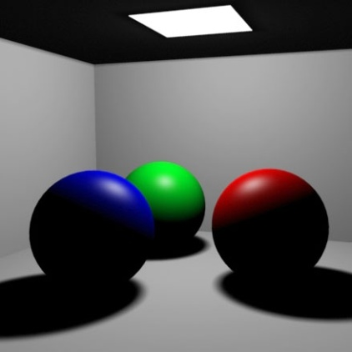
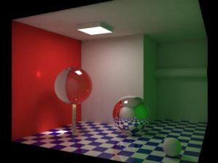
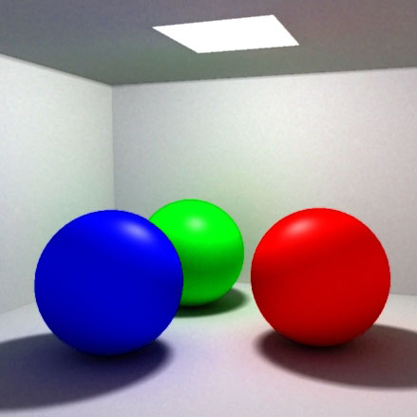
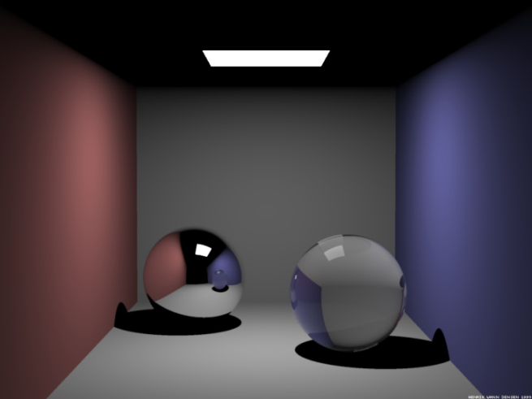
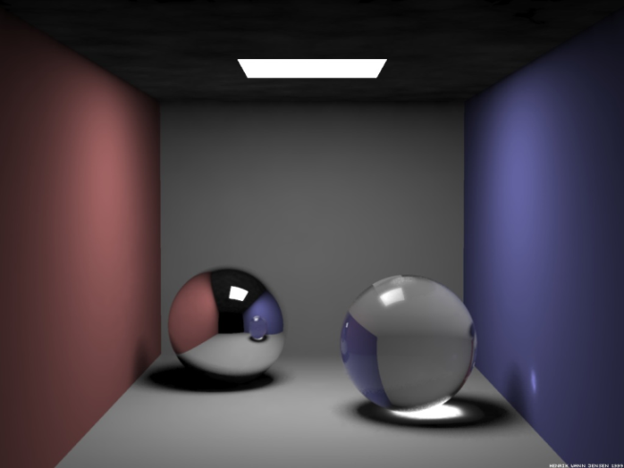
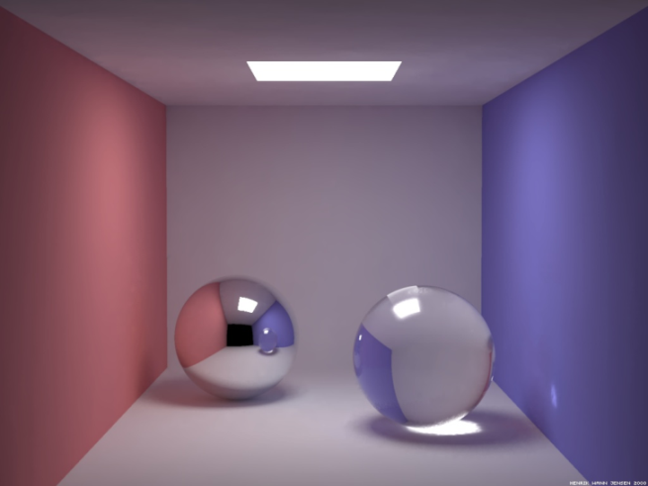
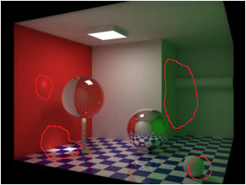
Examples of Global Models
The rendering equation takes into account global information of both direct (from emitters) and indirect illumination (inter-object reflections)
Many different approximations with advantages and disadvantages, and their own resource requirements – in general, more computation gives better results
Even purely local model is a zero’th order approximation to rendering eqn.
Direct illumination + specular reflection
Ray trace
+ soft shadows and caustics
Ray trace + caustic photon map
+ diffuse reflection (color bleeding)
Ray trace + caustic and diffuse photon maps
http://graphics.ucsd.edu/~henrik/images/global.html

Slide 14
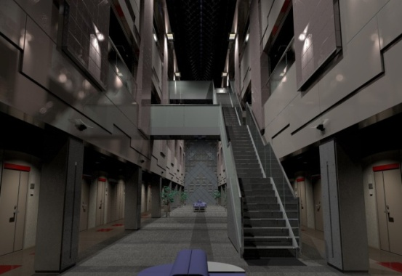
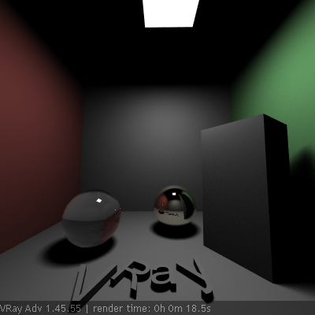
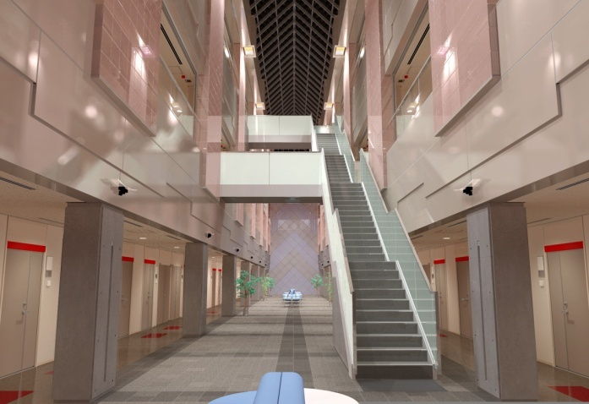
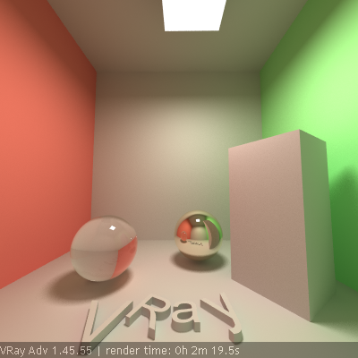
Illumination Models: Non-global vs. Global Models
Non-global models concentrate on light from direct sources
pro: scene can be rendered fast
con: pay a price in lost realism; lose interesting effects of light transport because we ignore effects of all other objects in the scene when considering a particular surface element
Global models concentrate on capturing all illumination information
pro: shadows, inter-object reflection, refraction, i.e. bending of light at translucent surfaces, caustics, volumetric effects of participating media such as air, water, fog, etc.
con: slow
Note that top image is darker because diffuse inter-object reflection is not counted, so no color bleeding. “Ambient” hack compensates for this difference
Direct (diffuse + specular) lighting + indirect specular reflection via recursive ray tracing
Full global model using stochastic simulation for diffuse interreflections (color bleeding)
Ray tracing +
Light cache + Irradiance map
http://www.spot3d.com/vray/help/200R1/examples_GI.htm

Slide 15
Illumination and Shading
Lighting, or illumination, is the process of computing the intensity and color of a sample point in a scene as seen by a viewer
lighting is a function of the geometry of the scene (including the model, lights and camera and their spatial relationships) and material properties
Shading is the process of interpolation of color at points in-between those with known lighting or illumination, typically vertices of triangles or quads in a mesh
used in many real time graphics applications (e.g., games) since calculating illumination at a point is usually expensive. In ray-tracing only do lighting for samples (based on pixels or sub-pixel samples for super-sampling)
On the GPU processing triangles, lighting is calculated by a vertex shader, while shading is done by a fragment or pixel shader

Slide 16
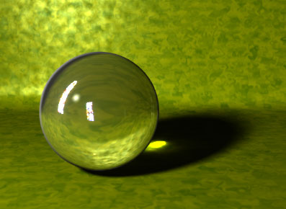
Outline
What is Light?
Local vs. Global Illumination
The Rendering Equation
Illumination vs. Shading
Computing Illumination
Modeling Reflectance
Illumination Models
Shading Models
Advanced Global Illumination Techniques

Slide 17
Illumination Models: Computing Illumination
Illumination can be computed by:
Light transport simulation: Evaluate illumination with enough samples to produce a final image without any guessing / shading, both for direct and for indirect components
often used for high quality renderers and movies
some implementations can run in real time on the GPU, but more complex lighting models that are difficult to parallelize for GPUs are still run on the CPU
renders of highest quality can take days for a single frame, even on modern distributed CPU render farms and/or GPU render farms
Many simulations use stochastic sampling: path tracing, photon mapping, metropolis light transport
Polygon rendering: Evaluate illumination at several samples, and shade (using a shading model) in between to produce pixels in the final image
often used in real-time applications such as computer games, done in GPU
lower quality than light transport simulation, but with various additions such as maps (bump, displacement, environment), can obtain satisfactory results

Slide 18
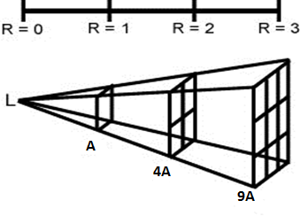
Light Transport: Inverse Square Law
In Ray assignment, you will consider light attenuation (affects all models)
Amount of light that illuminates an object decreases with square of distance between them
For a given 3D angle (solid angle), the area it covers grows with the square of the distance
Intensity of light per unit area falls off with the inverse square
Conversely, for a fixed area, the angle it covers decreases with the square of the distance

Slide 19
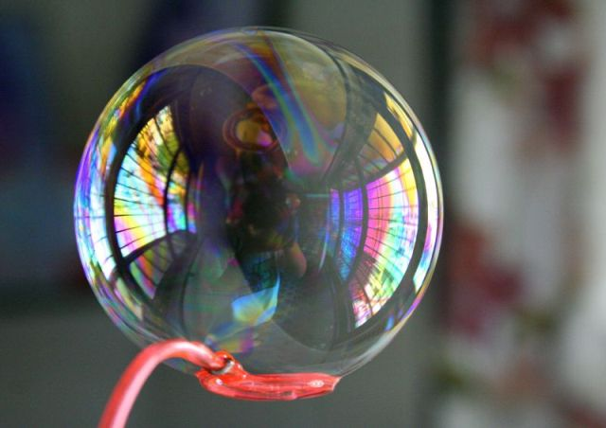
Outline
What is Light?
Local vs. Global Illumination
The Rendering Equation
Illumination vs. Shading
Computing Illumination
Modeling Reflectance
Illumination Models
Shading Models
Advanced Global Illumination Techniques
bubble with reflection, by d ha rm e sh

Slide 20
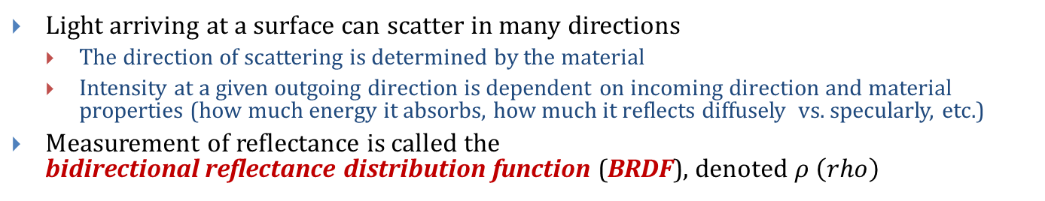
Modeling Reflectance: The BRDF (1/2)
Light arriving at a surface can scatter in many directions
The direction of scattering is determined by the material
Intensity at a given outgoing direction is dependent on incoming direction and material properties (how much energy it absorbs, how much it reflects diffusely vs. specularly, etc.)
Measurement of reflectance is called the bidirectional reflectance distribution function (BRDF), denoted $ρ \left(rho\right)$
specular reflection (big)
diffuse reflections
incident light beam
reflected scatter distribution BRDF
surface
Image credit: © Ben Herila, 2010

Slide 21
Modeling Reflectance: The BRDF (2/2)
When light hits a surface, it can be reflected, refracted, absorbed, or otherwise scattered (e.g., subsurface scattering)
BRDF represents material properties of an object and how it reflects light
Given an incoming direction, outgoing direction, incident point on object, and properties of lights, BRDF provides how much light reflects off surface
can be measured with equipment or estimated based on some model
Note that the BRDF is often implicit in simplest illumination models, and parameters (typically diffuse and specular reflection coefficients) are adjusted experimentally until desired visual outcome is achieved
For this course, primarily concern ourselves with simple reflectance models

Slide 22
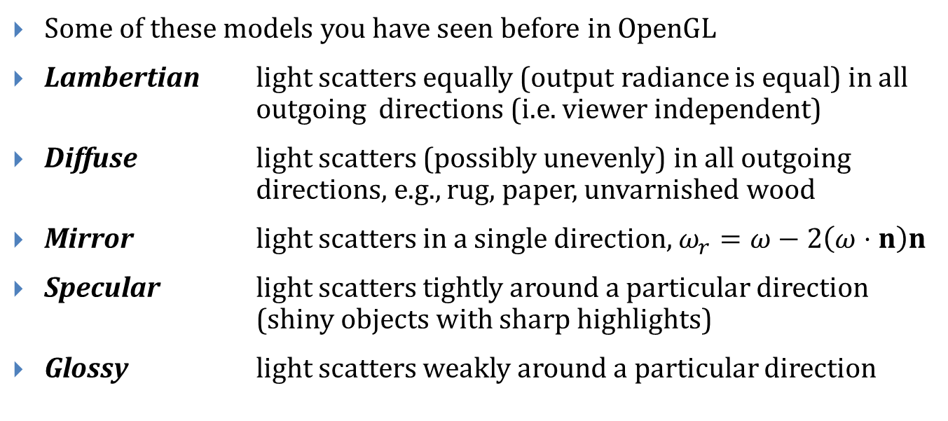
Simple Reflectance Models
Some of these models you have seen before in OpenGL
Lambertian light scatters equally (output radiance is equal) in all outgoing directions (i.e. viewer independent)
Diffuse light scatters (possibly unevenly) in all outgoing directions, e.g., rug, paper, unvarnished wood
Mirror light scatters in a single direction, $ω_{r}=ω−2\left(ω⋅n\right)n$
Specular light scatters tightly around a particular direction (shiny objects with sharp highlights)
Glossy light scatters weakly around a particular direction

Slide 23
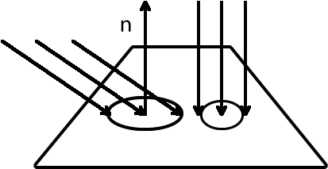
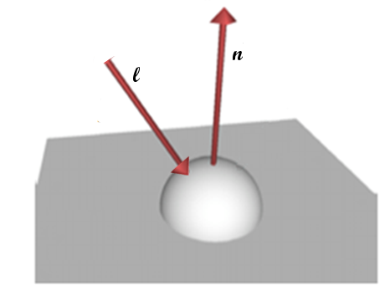
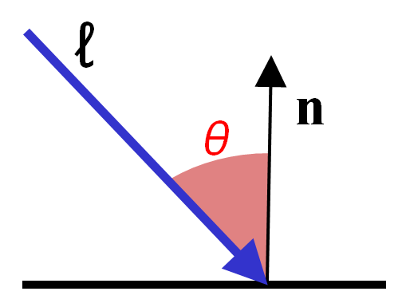
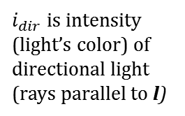
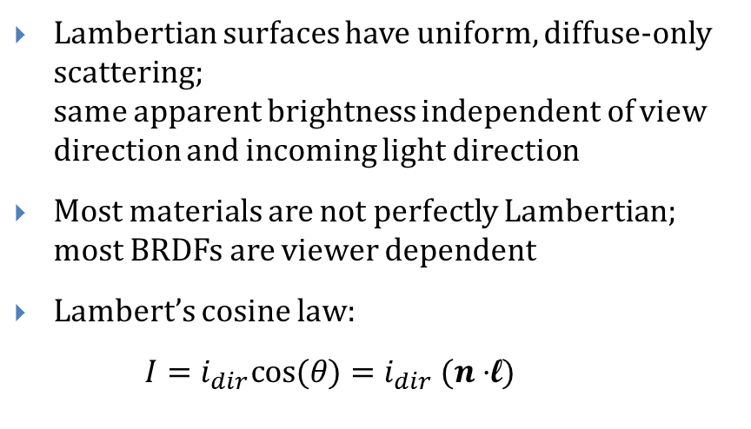
Modeling Reflectance: Lambertian (1/2)
Lambertian surfaces have uniform, diffuse-only scattering; same apparent brightness independent of view direction and incoming light direction
Most materials are not perfectly Lambertian; most BRDFs are viewer dependent
Lambert’s cosine law:
$I=i_{dir}cos⁡(θ)=i_{dir} (n⋅$l)
As angle between light and normal increases , light’s energy spreads across a larger area
$i_{dir}$ is intensity (light’s color) of directional light (rays parallel to l)
3D visualization: hemisphere represents equal magnitude of reflected intensity for any outgoing vector. Real surfaces will have asymmetric BRDFs.

Slide 24
Modeling Reflectance: Lambertian (2/2)
Several lighting models attempt to approximate these phenomena
Models you have seen before– no physical foundation, but looks okay
Phong Model
Blinn-Phong Model
Some more complicated models are physically based
Cook-Torrance Model
Oren-Nayer Model
Which model we use largely depends on our application
Usually a performance vs. accuracy tradeoff

Slide 25
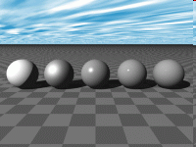
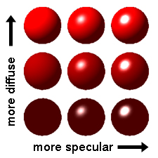
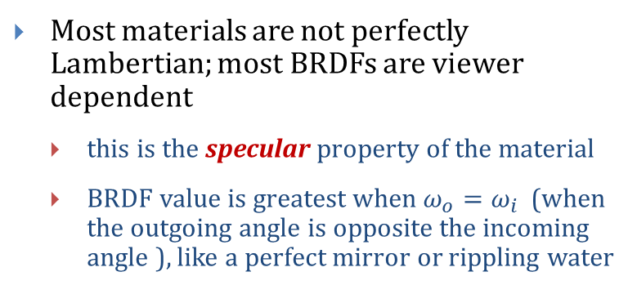
Modeling Reflectance: Specular
Most materials are not perfectly Lambertian; most BRDFs are viewer dependent
this is the specular property of the material
BRDF value is greatest when $ω_{o}=ω_{i}$ (when the outgoing angle is opposite the incoming angle ), like a perfect mirror or rippling water

Slide 26
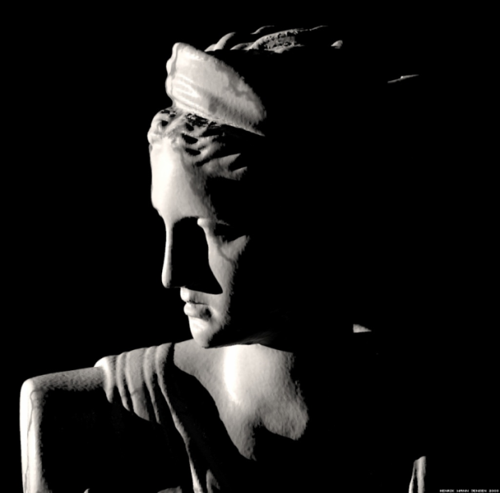
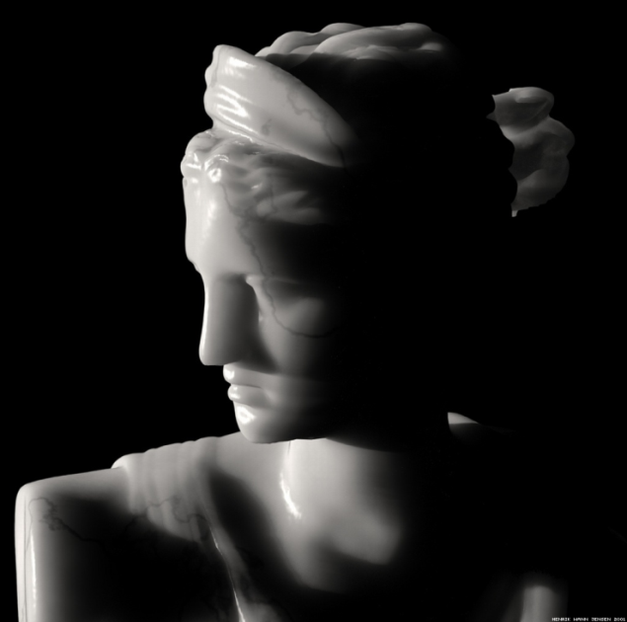
Modeling Reflection: BSSRDF
All of these models model light when it hits a surface directly
Light may also be scattered / absorbed while traveling through participating media (e.g., Fog)
The BRDF can be generalized to model transmission through an object (i.e., Refraction) and sub-surface scattering by defining other terms, such as the Bidirectional scattering surface reflectance distribution function (BSSRDF)
Image: No scattering (top) vs. with BSSRDF scattering (bottom).
Image credit: http://graphics.ucsd.edu/~henrik/images/subsurf.html

Slide 27
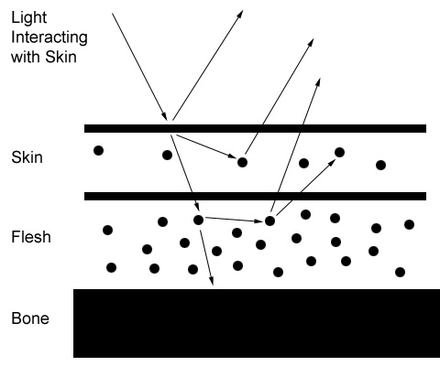
Modeling Reflectance: Subsurface Scattering
Some surfaces may also reflect light internally a little before letting the light escape again (subsurface scattering)
marble, skin, wax, hair, milk and other fluids
More complex models are needed to approximate these interactions

Slide 28
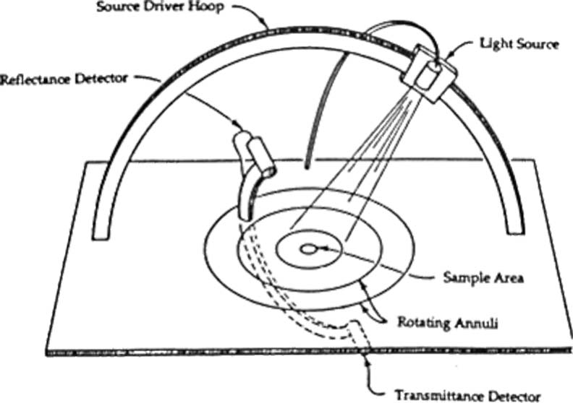
Modeling Reflectance: Measuring B*DFs
Researchers collect tables of data for B*DFs of specific materials using devices like the one pictured
The basic idea is to vary a light source around a hemisphere and measure the intensity at that direction.
Image credit: Chuck Moidel

Slide 29
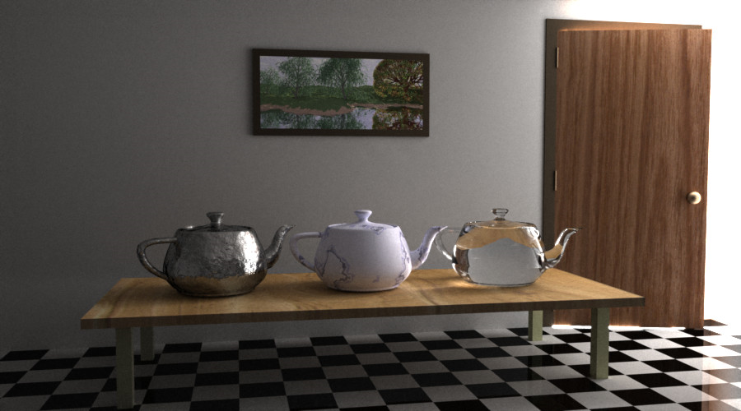
Outline
What is Light?
Local vs. Global Illumination
The Rendering Equation
Illumination vs. Shading
Computing Illumination
Modeling Reflectance
Illumination Models
Shading Models
Advanced Global Illumination Techniques

Slide 30
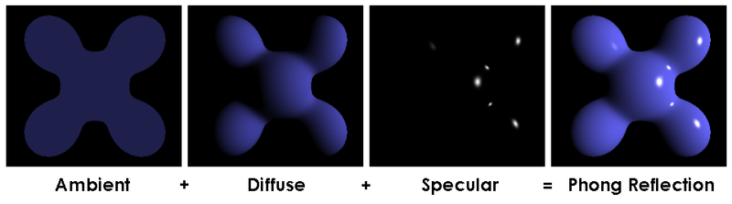
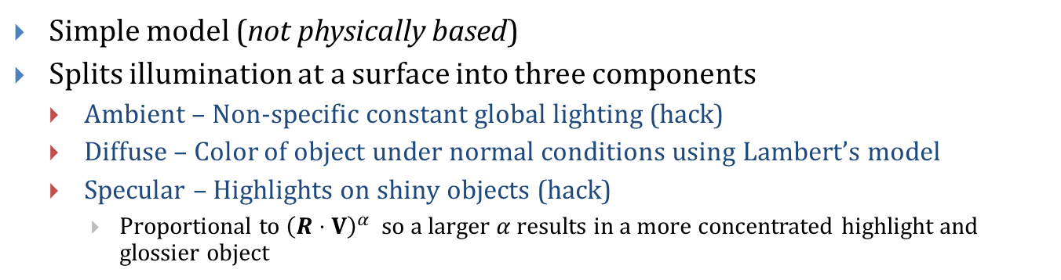
Illumination Models: Phong (1/5) (Review)
Simple model (not physically based)
Splits illumination at a surface into three components
Ambient – Non-specific constant global lighting (hack)
Diffuse – Color of object under normal conditions using Lambert’s model
Specular – Highlights on shiny objects (hack)
Proportional to ${\left(R⋅V\right)}^{α}$ so a larger $α$results in a more concentrated highlight and glossier object

Slide 31
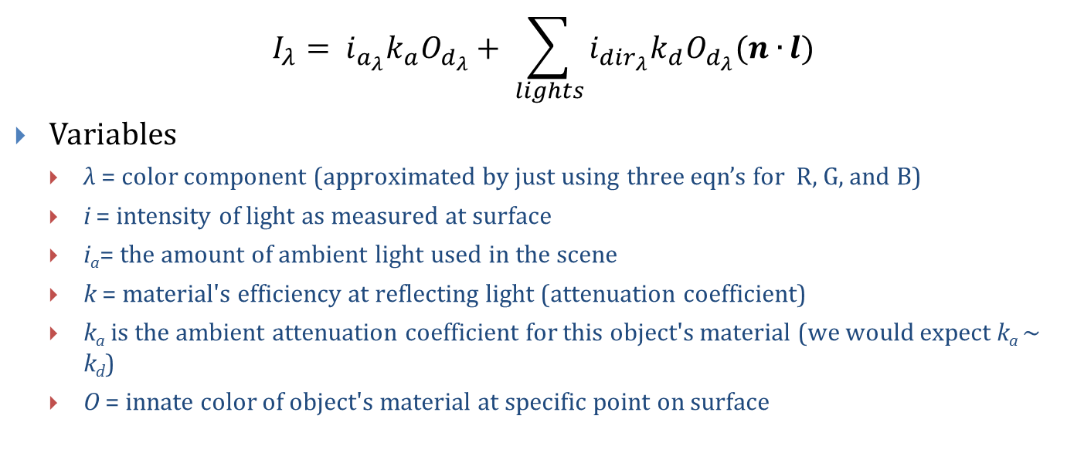
Illumination Models: Phong (2/5) (Review)
$$I_{λ}= i_{a_{λ}}k_{a}O_{d_{λ}}+ \sum_{lights}{i_{{dir}_{λ}}k_{d}O_{d_{λ}}(n∙}l)$$
Variables
λ = color component (approximated by just using three eqn’s for R, G, and B)
i = intensity of light as measured at surface
i_{a}= the amount of ambient light used in the scene
k = material's efficiency at reflecting light (attenuation coefficient)
k_{a} is the ambient attenuation coefficient for this object's material (we would expect k_{a} ~ k_{d})
O = innate color of object's material at specific point on surface

Slide 32
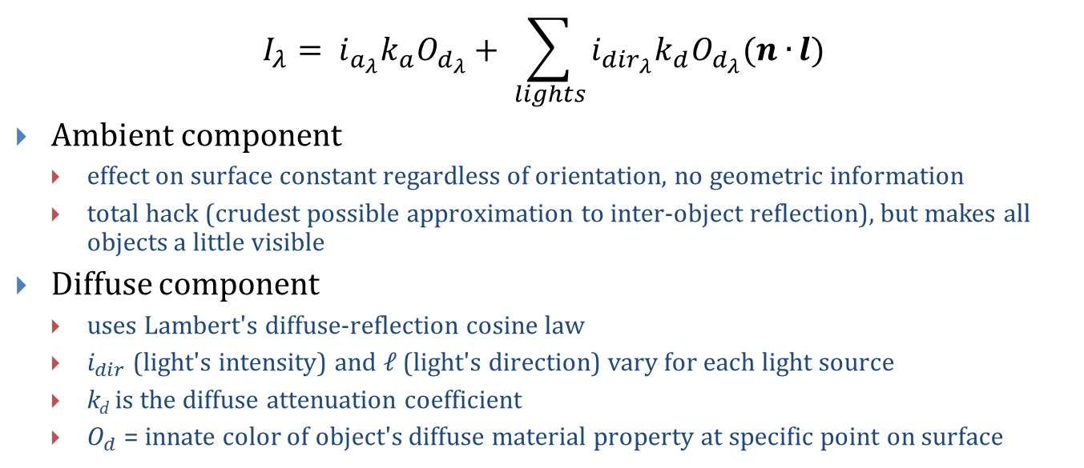
Illumination Models: Phong (3/5) (Review)
$$I_{λ}= i_{a_{λ}}k_{a}O_{d_{λ}}+ \sum_{lights}{i_{{dir}_{λ}}k_{d}O_{d_{λ}}(n∙}l)$$
Ambient component
effect on surface constant regardless of orientation, no geometric information
total hack (crudest possible approximation to inter-object reflection), but makes all objects a little visible
Diffuse component
uses Lambert's diffuse-reflection cosine law
$i_{dir}$ (light's intensity) and ℓ (light's direction) vary for each light source
k_{d} is the diffuse attenuation coefficient
$O_{d}$ = innate color of object's diffuse material property at specific point on surface

Slide 33
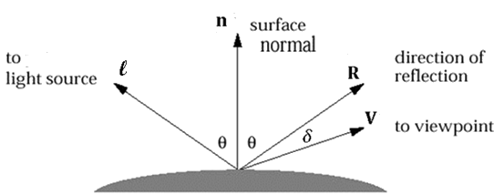
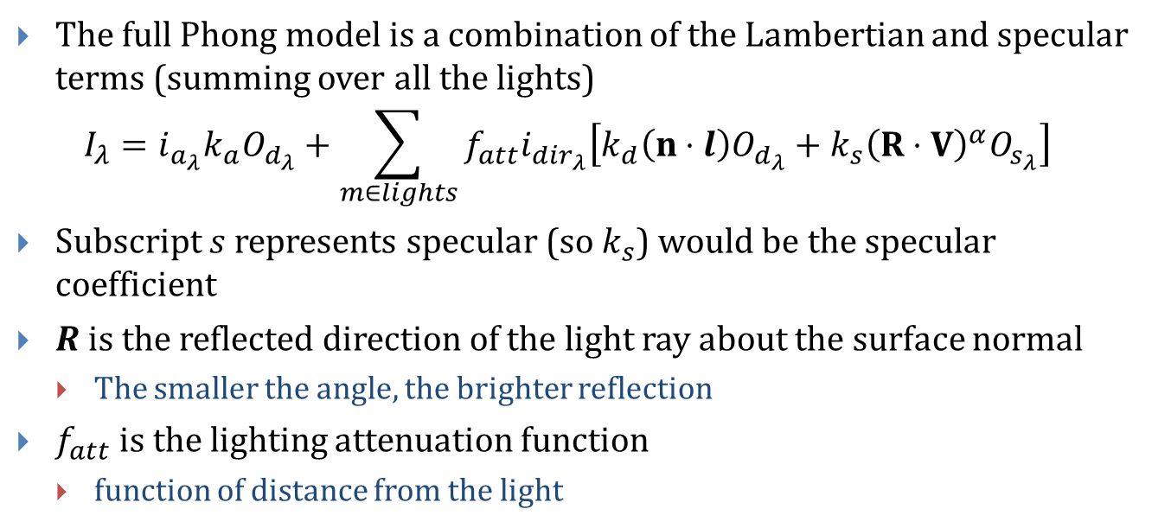
Illumination Models: Phong (4/5) (Review)
The full Phong model is a combination of the Lambertian and specular terms (summing over all the lights) $I_{λ}=i_{a_{λ}}k_{a}O_{d_{λ}}+\sum_{m∈lights}{f_{att}i_{{dir}_{λ}}\left[k_{d}\left(n⋅l\right)O_{d_{λ}}+k_{s}{\left(R⋅V\right)}^{α}O_{s_{λ}}\right]}$
Subscript $s$represents specular (so $k_{s}$) would be the specular coefficient
$R$is the reflected direction of the light ray about the surface normal
The smaller the angle, the brighter reflection
$f_{att}$is the lighting attenuation function
function of distance from the light
Note: for a directional light, l is simply a directional vector. For a point light, l must be computed from the light’s positions and the surface point.

Slide 34



Illumination Models: Phong (5/5) (Review)
By the inverse square law, density of light energy decreases by the inverse square of the distance from the surface, due to spherical radiation pattern, so
$I=\left(f_{att}\right)\left(i_{dir}k_{d}\right)\left(n⋅l\right)$, where $f_{att}=\frac{1}{d_{light}^{2}}$
This will attenuate the light intensity according to distance, so farther objects appear darker, i.e. surfaces with equal $\left(k_{d}\right)\left(n⋅l\right)$ vary in appearance if they are at different distances from the light – important if two surfaces overlap
But this doesn’t look good – objects illuminated by point lights will look as if they were very harshly lit (things get dark too fast)
Instead, use the following heuristic
$$f_{att}=\min\left\{\frac{1}{c_{1}+c_{2}d_{light}+c_{3}d_{light}^{2}},1\right\}$$
where c₁, c₂, c₃ are experimentally-defined constants (this is a hack)

Slide 35


Illumination Models: Blinn-Phong
Variation on Phong model which modifies the specular term to be more computationally efficient
The new specular term uses the half angle between the viewer and the light (constant throughout the scene) instead of the angle between the surface and the light (varying for each triangle) $\sum_{m∈lights}{i_{d}k_{s}O_{s}{\left(n⋅h\right)}^{α}}$
$h$ is the half angle $h=\frac{l+V}{\left|l+V\right|}$
l is the direction from the point to the light
Use Blinn-Phong or Phong?
Doesn’t matter, they look slightly different but they’re both hacks

Slide 36



Illumination Models: Computing Results
$$k_{s}O_{sλ}{\left(R⋅V\right)}^{α}$$
Look closely at the specular term:
We can compute this term recursively
shoot a ray from eye through a pixel on the screen
calculate intersections of ray with all primitives in the scene, pick the closest one
shoot a specular reflection ray from the intersection point to closest object to calculate its specular contribution
apply our simple illumination model at intersection point
can even be done in hardware thanks to modern GPU’s
This is recursive Ray Tracing – simple global model that only computes specular inter-object reflection
You will be implementing soon

Slide 37

Outline
What is Light?
Local vs. Global Illumination
The Rendering Equation
Illumination vs. Shading
Computing Illumination
Modeling Reflectance
Illumination Models
Shading Models
Advanced Global Illumination Techniques

Slide 38

Shading Models – Flat/Constant (Review)
We define a normal at each polygon (not at each vertex)
Lighting: Evaluate the lighting equation at the center of each polygon using the associated normal
Shading: Each sample point on the polygon is given the interpolated lighting value at the vertices (i.e. a total hack)

Slide 39



Shading Models – Gouraud (Review)
Define a normal vector at each vertex
Lighting: Evaluate lighting equation at each vertex using associated normal vector
Shading: Each sample point’s color on polygon is interpolated from color values at polygon’s vertices
An issue with Gouraud shading is that specular highlights appear to “jump” as the object rotates. Simple fix is to increase polygon count, at cost of much more computation.

Slide 40

Shading Models – Phong (Review)
Each vertex has an associated normal vector
Lighting: Evaluate lighting equation at each vertex using associated normal vector
Shading: For every sample point on polygon we interpolate normals at vertices of the polygon and compute color using lighting equation with the interpolated normal at each interior pixel – more accurate representation of true surface normal at each point (and we don’t get moving specular highlights)

Slide 41

Outline
What is Light?
The Rendering Equation
Illumination vs. Shading
Local vs. Global Illumination
Computing Illumination
Modeling Reflectance
Illumination Models
Shading Models
Advanced Global Illumination Techniques

Slide 42
Advanced GI Techniques
In practice, calculating global illumination for a scene is a very complex and computationally intensive task
Many algorithms (both real time and non real time) have been developed to calculate or approximate global illumination
Real time
Ambient occlusion, image based lighting
Not (yet) real time
Radiosity (intro later), Metropolis light transport, photon mapping, point based color bleeding

Slide 43

Advanced GI Techniques
Advanced GI Techniques
Photon Mapping
Mental Ray Renderer Bioshock 2
Determine amount of light at a point by sending packets of energy (photons) from each light source out into the scene and counting how many are in neighborhood around that point.
Photon Mapping
Mental Ray Renderer Bioshock 2
Determine amount of light at a point by sending packets of energy (photons) from each light source out into the scene and counting how many are around that point.

Slide 44

Advanced GI Techniques
Advanced GI Techniques
Point-Based Color Bleeding
Renderman Renderer Up!
First generates a direct illumination point cloud. Uses the point cloud for lookup during rendering to approximate diffuse light bounces by adding up the contribution from other points in the cloud.
Point-Based Color Bleeding
Renderman Renderer Up!
First generates a direct illumination point cloud. Uses the point cloud for lookup during rendering to approximate diffuse light bounces by adding up the contribution from other points in the cloud.

Slide 45


Advanced GI Techniques
Advanced GI Techniques
Image Based Lighting
Sunflow Renderer Shiny Aliens
Take a picture of a mirrored sphere in some environment, and use the color on the sphere to determine the global illumination in the scene
Image Based Lighting
Sunflow Renderer Shiny Aliens
Plot an image onto a dome or sphere, using the lighting properties of this surface to determine global illumination when rendering the scene.

Slide 46
Appendix: Math concepts and equations
Solid angles, BRDFs

Slide 47



Computing Illumination: Light Transport (1/4)
Light may arrive at a point from a range of directions (denoted as $Ω$) which is often called the solid angle, the 3D equivalent of a 2D angle
2D angle is related to the arc length, where l is the arc length and r is the radius of the circle
$$θ=\frac{l}{r}$$
In 3D, solid angle (measured in steradians) is related to the surface area it cuts out, where S is the surface area and r is the radius of the sphere ¹
$$Ω=\frac{S}{r^{2}}$$
$$Ω$$
¹ For the proof, consult the textbook or take cs224
Image credit: © Ben Herila, 2010

Slide 48





Computing Illumination: Light Transport (2/4)
$$ω∈Ω$$
$$Ω$$
Amount of light arriving at a surface at a certain point in time as an integral over the solid angle $Ω$
$$E=\int_{A}{\int_{ω∈Ω}{L\left(t,x,y,ω,λ\right)|ω⋅n|dω}dA}$$
This measure of light energy is known as irradiance
Let’s break the integral down…
$$n$$
$$dA$$
y
x
illuminating hemisphere
Image credit: © Ben Herila, 2010

Slide 49

Computing Illumination: Light Transport (3/4)
$$ω∈Ω$$
$$E=\int_{A}{\int_{ω∈Ω}{L\left(t,x,y,ω,λ\right)|ω⋅n|dω}dA}$$
$Ω$ is the solid angle, which includes all directions of incoming light
$ω$ is one direction out of all the possible directions, thus $ω∈Ω$
$λ$ is the wavelength (color) of the incoming light
$\left(x,y\right)$ is the point on the differential area over which we are integrating
$t$ is the time (constant for static scenes)
$$Ω$$
$$n$$
$$dA$$
y
x
illuminating hemisphere
Image credit: © Ben Herila, 2010

Slide 50




Computing Illumination: Light Transport (4/4)
$$E=\int_{A}{\int_{ω∈Ω}{L\left(t,x,y,ω,λ\right)|ω⋅n|dω}dA}$$
$\left|ω⋅n\right|\sim$ the cosine of the angle of the normal of the surface to the incoming light direction
Lambert’s cosine law
Light reflected from a surface is proportional to the cosine of the angle between the view direction the surface normal
For the same amount of energy:
when the incoming energy is aligned with the normal vector, you get the greatest energy per unit area (flux)
When the angle is acute, the same amount of energy is distributed over a larger area; hence, the flux is less
n
$$ω$$
direct radiation (W/m²)
$$θ$$
$$θ=acos\left(ω⋅n\right)$$
Image credit: © Ben Herila, 2010

Slide 51







Modeling Reflectance: The BRDF (2/3)
$$ω_{i}∈Ω$$
The BRDF ($ρ$) can be written as the fraction of outgoing light over incoming light at a given angle ¹
$$ρ\left(p,ω_{i},ω_{o},λ\right)=\frac{L(t,p,ω_{o}λ)}{L\left(t,p,−ω_{i},λ\right)\cos\left(φ\right)m(Ω)}$$
$m(Ω)$ is the measure of the solid angle projected by the light source at the sample
$ω_{i,o}$are the incoming and outgoing light directions, respectively
$p≡(x,y)$ for brevity
$λ$ is the wavelength, as before
$t$ is the current time, as before
$$Ω$$
$$n$$
$$ω_{o}$$
$$φ$$
$$dA$$
y
x
¹ Again, for the proof, consult the textbook or take cs224
Image credit: © Ben Herila, 2010

Slide 52

Modeling Reflectance: The BRDF (3/3)
$$ρ\left(p,ω_{i},ω_{o},λ\right)=\frac{L(t,p,ω_{o}λ)}{L\left(t,p,−ω_{i},λ\right)\cos\left(φ\right)m(Ω)}$$
The BRDF of most materials satisfies Helmholtz reciprocity
$$ρ\left(p,ω_{i},ω_{o},λ\right)=ρ\left(p,ω_{o},ω_{i},λ\right)$$

Slide 53


Modeling Reflectance
Let’s put together what we have so far
Amount of light reflected at a given surface point $p=\left(x,y\right)$ is $L\left(t,p,ω_{o},λ\right)=\int_{ω∈Ω^{+}}{L\left(t,p,ω_{i},λ\right)ρ\left(p,ω_{i},ω_{o},λ\right)\left|ω_{i}⋅n\right|dω_{i}}$
Very similar to the formula for irradiance
Preliminary form of the rendering equation
sum of all incoming light at $p$
multiplied by the BRDF of the surface corresponding to each light direction
attenuated by the cosine of the angle

Slide 54

Illumination Models: Lambertian (2/2)
To compute the integral we saw before, simply sum over all the lights in the scene:
$$i_{λ}=\sum_{m∈lights}{i_{d_{λ}}{k_{d}}_{λ}\left(n⋅L_{m}\right)O_{d}}$$
$λ$ is the wavelength or color (i.e. R, G, or B)
$i$ is the light intensity measured at the object surface
$k$is the material’s efficiency at reflecting light (attenuation coefficient)
$O$ represents the color of an object’s material at a point (the BRDF for a diffuse material)
$L$is the direction to the light from the surface point
$n$ is the surface normal at the point
Subscript $a$ and $d$ represent ambient and diffuse (so $k_{a}$ is the ambient coefficient)

Slide 55


Modeling Reflectance (1/2)
When light hits a material, it scatters according to the properties of that material
There are several types of light scattering
Reflective – Light scatters in the upper hemisphere
Transmissive – Light scatters in the lower hemisphere
Impulse – Light scatters in a single direction (regardless of incoming direction)
Single reflective ray
reflection angle $φ$ is acute
Single transmissive ray
reflection angle $φ$ is obtuse
Impulse rays
incoming rays all exit in same direction
Image credit: © Ben Herila, 2010

Slide 56
Embedded Font
ABCDEFGHIJKLMNOPQRSTUVWXYZ
a b c d e f g h i j k l m n o p q r s t u v w x y z
1234567890
ABCDEFGHIJKLMNOPQRSTUVWXYZ
a b c d e f g h i j k l m n o p q r s t u v w x y z
1234567890
ABCDEFGHIJKLMNOPQRSTUVWXYZ
a b c d e f g h i j k l m n o p q r s t u v w x y z
1234567890
(Hidden slide, to ensure that all characters are embedded for future editing)
!@#$%^&*()_+-=~`,./;’[]{}:”>?<

Slide 57















Diagram Src (hidden slide)
$$ω_{i}∈Ω$$
$$ω_{i}, ω_{j},ω_{k}∈Ω$$
$$n$$
$$ω_{i}∈Ω$$
$$φ$$
$$ω_{o}$$
$$n$$
$$ω_{o}$$
$$n$$
$$dA$$
y
$$φ$$
$$φ$$
x
$$dA$$
$$dA$$
$$ω_{o}$$
y
y
x
x
Note from bherila (diagram author): Things get messed up if you try to use this diagram in the slide directly (i.e. when you scale it). So if you want to edit the diagram, edit it on this slide and then copy -> paste-special as enhanced metafile (EMF) on the previous slide. There you can scale and animate as you please.

